Slide 1
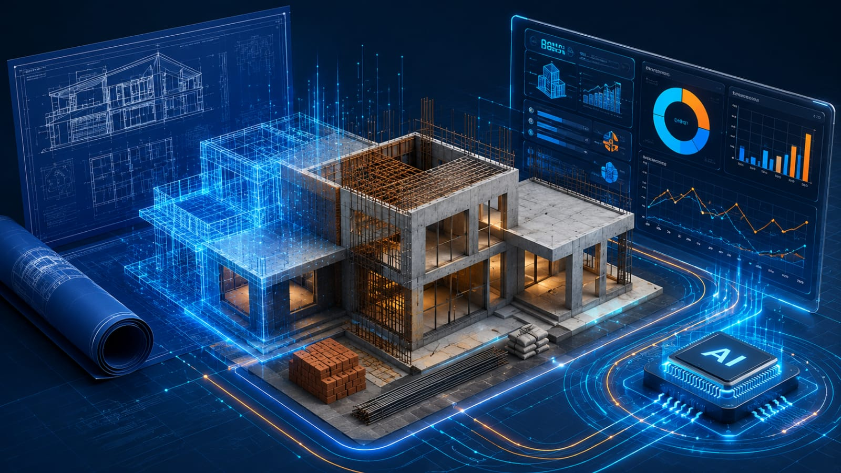
GNIOT | CSE AI & ML
IMAGE PLACEHOLDER
BuildMetrics AI
3D Construction + AI Dashboard
Insert a high-quality isometric illustration of a residential building blueprint transforming into a digital cost dashboard. Use navy, cyan and orange lighting. No text, no watermark.
Automated Civil Construction Cost Estimation
& Quantity Modeling Engine
A practical bridge between civil engineering quantity surveying and machine-learning-based cost prediction.
Project Team
Shambhu Shekhar Sinha (2401321530048)
Vaibhav Kumar Tiwari (2401321530062)
Rishu Raj (2401321530040)
BuildMetrics AI | Automated Construction Cost Estimation
1

Slide 2

Executive Vision
PROJECT VISION
Transforming civil quantity surveying through automation, predictive analytics and rapid BOQ generation.
IMAGE PLACEHOLDER
Digital Quantity Surveying
• Automates concrete, steel, brick and mortar quantity calculations.
• Uses Ridge and XGBoost regression for location- and quality-adjusted budgeting.
• Generates downloadable PDF BOQs through ReportLab and io.BytesIO.
• Provides interactive cost charts through a Streamlit dashboard.
Insert a split-screen image: traditional quantity surveyor with drawings on the left and a modern AI construction dashboard on the right. Professional academic style.
BuildMetrics AI | Automated Construction Cost Estimation
2

Slide 3
The Problem: Slow and Volatile Construction Budgeting
PROBLEM
1
Manual BOQ Delays
Manual quantity and BOQ preparation can take 3–7 days per project sheet.
2
Calculation Errors
Rebar, concrete and masonry calculations are vulnerable to human error.
3
Price Volatility
Static spreadsheets do not respond well to changing material prices.
Note: AI values are proposed project targets, not experimentally validated results.
BuildMetrics AI | Automated Construction Cost Estimation
3

Slide 4
Project Objectives
OBJECTIVES
01
Automate Surveying
02
Deploy ML Regression
Compute concrete, rebar, brick and mortar quantities automatically.
Predict total budget using material quality and regional indices.
03
Build Accessible UI
04
Export PDF BOQs
Provide Streamlit sliders, selectors and Plotly visualizations.
Generate structured BOQ reports in under five seconds.
BuildMetrics AI | Automated Construction Cost Estimation
4

Slide 5
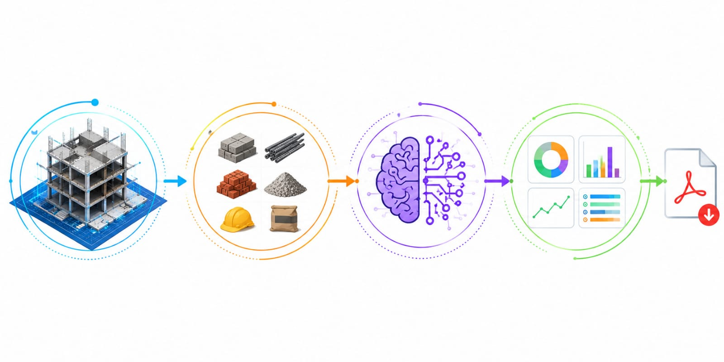
Proposed Solution
SOLUTION
1. Quantity Engine
2. ML Cost Engine
3. BOQ Export Engine
IS-456-inspired formulas
Concrete • Steel • Bricks • Mortar
Ridge / XGBoost
Quality and location adjustment
ReportLab + io.BytesIO
Downloadable itemized PDF
IMAGE PLACEHOLDER
Recommended Visual: Quantity-to-Cost Pipeline
Insert a clean horizontal infographic showing a building outline, material quantities, AI prediction and a downloadable BOQ report.
BuildMetrics AI | Automated Construction Cost Estimation
5

Slide 6
BuildMetrics AI End-to-End Workflow
FLOWCHART
User Inputs
Streamlit UI
Civil Math
ML Model
Results
Area • Floors • Tier
Sliders • Validation
Concrete • Rebar • Bricks
Ridge / XGBoost
Cost • Charts • BOQ
SQLite Logging
PDF Export
projects_log history
ReportLab + BytesIO
The workflow transforms simple project parameters into a transparent quantity schedule, estimated budget, project history and downloadable BOQ.
BuildMetrics AI | Automated Construction Cost Estimation
6

Slide 7

System Architecture: Four-Tier Modular Design
ARCHITECTURE
Tier 1 | Presentation
IMAGE PLACEHOLDER
Streamlit Web UI
Inputs • sliders • Plotly charts
Layered Architecture Illustration
Tier 2 | Civil Logic
Insert a modern four-layer software architecture illustration. Show UI at the top, civil logic below it, ML engine next, and database/PDF export at the bottom. Use connected arrows.
civil_math.py
Concrete • steel • masonry formulas
Tier 3 | AI/ML Core
cost_engine.py
Joblib • scaling • regression
Tier 4 | Data & Export
SQLite • ReportLab
projects_log • io.BytesIO
BuildMetrics AI | Automated Construction Cost Estimation
7

Slide 8
Technical Methodology
METHODOLOGY
IS-456-Inspired Quantity Logic
ML Serialization and Caching
Concrete volume:
V = Area × Thickness × Floors
Steel weight:
W = V × 1.5% × 7850 kg/m³
Brickwork:
Bricks = Perimeter × Height × Factor
Dry mortar:
Dry volume = Wet volume × 1.54
• Train Scikit-Learn / XGBoost models offline.
• Serialize the pipeline using joblib.
• Preserve scalers and feature encodings.
• Load the model through Streamlit caching.
• Reduce repeated loading and inference overhead.
BuildMetrics AI | Automated Construction Cost Estimation
8

Slide 9
Illustrative Cost Trend by Built-Up Area
ANALYTICS
500 sq ft
Illustrative cost: ₹12.5 lakh
1,500 sq ft
Illustrative cost: ₹35.2 lakh
2,500 sq ft
Illustrative cost: ₹58.1 lakh
Use this as an illustrative trend unless the values are exported directly from the trained model.
BuildMetrics AI | Automated Construction Cost Estimation
9

Slide 10
Material Cost Composition Dashboard
DASHBOARD
Concrete
Steel
Quantity: m³
Cost share: 42%
Quantity: kg
Cost share: 31%
Bricks
Mortar
Quantity: units
Cost share: 17%
Quantity: m³
Cost share: 10%
IMAGE PLACEHOLDER
Dashboard Screenshot
Replace this box with a screenshot of the Streamlit interface showing sliders, cost cards and a Plotly chart.
BuildMetrics AI | Automated Construction Cost Estimation
10

Slide 11
Database Architecture and Project Logging
DATABASE
project_id
IMAGE PLACEHOLDER
TEXT PRIMARY KEY
SQLite Schema Diagram
timestamp
DATETIME
Insert a clean database diagram showing projects_log as a table with the seven fields connected to the Streamlit application and the PDF export module.
built_up_area
REAL
floors
INTEGER
quality_tier
TEXT
calculated_boq
JSON
predicted_cost
REAL
BuildMetrics AI | Automated Construction Cost Estimation
11

Slide 12
Export Engine: In-Memory PDF Generation
EXPORT
ReportLab Flowables
io.BytesIO Buffer
• Paragraphs and formatted headings
• Tables for itemized BOQ entries
• Headers, logos and project metadata
• Consistent professional formatting
• Builds the PDF directly in RAM
• Avoids temporary disk files
• Supports direct browser download
• Designed for fast non-blocking export
IMAGE PLACEHOLDER
PDF BOQ Preview
BuildMetrics AI | Automated Construction Cost Estimation
12
Insert a screenshot of a generated BOQ PDF containing project details, material quantities, unit rates, totals and a professional header.

Slide 13
Research Integration and Project Positioning
RESEARCH
NLP & Layout
2D-to-3D Vision
Requirement parsing and spatial planning concepts.
Blueprint detection and parametric reconstruction.
Deep Takeoff
Dynamic Pricing
Room segmentation and material quantification.
Regression, market adjustment and BOQ alignment.
BuildMetrics AI focuses its MVP on fast parametric quantity estimation and construction cost prediction for low-rise residential projects.
IMAGE PLACEHOLDER
Literature Map
13
BuildMetrics AI | Automated Construction Cost Estimation
Optional: add a small visual map connecting published methods to the modules adopted in BuildMetrics AI.

Slide 14
Scope, Feasibility and Risk Mitigation
FEASIBILITY
In Scope
MVP Limits and Risks
• Residential buildings from 1–4 floors
• Standard rectangular plots
• IS-456-based quantity ratios
• Standard and Premium material tiers
• Automated PDF BOQs and SQLite logs
• Irregular CAD parsing is excluded
• High-rise buildings are excluded
• Deep-pile geotechnical anomalies are excluded
• Live vendor-price scraping is future work
• Use regional indices, tooltips and lightweight deployment
BuildMetrics AI | Automated Construction Cost Estimation
14

Slide 15
Team Work Division and Development Roadmap
EXECUTION
Shambhu | ML & Integration
Vaibhav | UI & Database
Rishu | Civil & Export
Model training, cost_engine.py, Joblib serialization, GitHub management and system integration.
Streamlit dashboard, Plotly charts, SQLite logging and responsiveness testing.
Civil quantity formulas, ReportLab PDF generation, BytesIO and documentation.
Weeks 1–2
Weeks 3–4
Week 5
Week 6
Foundation + Math
UI + Database
PDF + Hosting
Testing + Deliverables
BuildMetrics AI | Automated Construction Cost Estimation
15

Slide 16
Deliverables and Future Enhancements
NEXT STEPS
Expected Deliverables
Future Enhancements
• Deployed Streamlit web application
• Modular Python codebase
• Formal synopsis and architecture diagrams
• SQLite project-history database
• Downloadable PDF BOQ reports
• Testing logs and demonstration video
• Irregular CAD and blueprint parsing
• Live vendor-price APIs
• BIM/IFC quantity extraction
• Room-level deep-learning takeoff
• Weather and construction-risk prediction
• Interactive 3D building visualization
BuildMetrics AI | Automated Construction Cost Estimation
16

Slide 17
Thank You
IMAGE PLACEHOLDER
Final Project Visual
BuildMetrics AI
Automated Construction Cost Estimation
& Quantity Modeling Engine
Insert a premium isometric image of a completed low-rise residential building surrounded by blueprint lines, data points and a subtle AI network overlay. Navy and cyan color palette.
Questions and faculty feedback
BuildMetrics AI | Automated Construction Cost Estimation
17

